Slide 1
Instruction Set Architecture
國立清華大學資訊工程學系
黃婷婷教授

Slide 2
Outline
Instruction set architecture
Operands
Register operands and their organization
Memory operands, data transfer
Immediate operands
Signed and unsigned numbers
Representing instructions
Operations
Logical
Decision making and branches
Supporting procedures in hardware
Communicating with people
Addressing for 32-bit immediate and addresses
Translating and starting a program
A sort example
Arrays versus pointers
ARM and x86 instruction sets

Slide 3
Outline
Instruction set architecture
Operands
Register operands and their organization
Memory operands, data transfer
Immediate operands
Signed and unsigned numbers
Representing instructions
Operations
Logical
Decision making and branches
Supporting procedures in hardware
Communicating with people
Addressing for 32-bit immediate and addresses
Translating and starting a program
A sort example
Arrays versus pointers
ARM and x86 instruction sets

Slide 4
What Is Computer Architecture?
Computer Architecture = Instruction Set Architecture + Machine Organization
“... the attributes of a [computing] system as seen by the [____________ language] programmer, i.e. the conceptual structure and functional behavior …”
assembly
What are specified?

Slide 5
Recall in C Language
Operators: +, -, *, /, % (mod), ...
7/4==1, 7%4==3
Operands:
Variables: lower, upper, fahr, celsius
Constants: 0, 1000, -17, 15.4
Assignment statement:
variable = expression
Expressions consist of operators operating on operands, e.g.,
celsius = 5*(fahr-32)/9;
a = b+c+d-e;

Slide 6
When Translating to Assembly ...
a = b + 5;
load $r1, M[b]
load $r2, 5
add $r3, $r1, $r2
store $r3, M[a]
Statement
Constant
Operands
Memory
Register
Operator (op code)

Slide 7
Components of an ISA
Organization of programmable storage
registers
memory: flat, segmented
modes of addressing and accessing data items and instructions
Data types and data structures
encoding and representation
Instruction formats
Instruction set (or operation code)
ALU, control transfer, exceptional handling

Slide 8
MIPS ISA as an Example
Registers
Instruction categories:
Load/Store
Computational
Jump and Branch
Floating Point
Memory Management
Special
$r0 - $r31
PC
HI
LO
3 Instruction Formats: all 32 bits wide
OP
$rs
$rt
$rd
sa
funct
OP
$rs
$rt
immediate
OP
jump target

Slide 9
Outline
Instruction set architecture
Operands
Register operands and their organization
Memory operands, data transfer
Immediate operands
Signed and unsigned numbers
Representing instructions
Operations
Logical
Decision making and branches
Supporting procedures in hardware
Communicating with people
Addressing for 32-bit immediate and addresses
Translating and starting a program
A sort example
Arrays versus pointers
ARM and x86 instruction sets

Slide 10
Operations of Hardware
Syntax of basic MIPS arithmetic/logic instructions:
1 2 3 4
add $s0,$s1,$s2 # f = g + h
1) operation by name
2) operand getting result (“destination”)
3) 1st operand for operation (“source1”)
4) 2nd operand for operation (“source2”)
Each instruction is 32 bits
Syntax is rigid: 1 operator, 3 operands
Why? Keep hardware simple via regularity
Design Principle 1: Simplicity favors regularity
Regularity makes implementation simpler
Simplicity enables higher performance at lower cost

Slide 11
Example
How to do the following C statement?
f = (g + h) - (i + j);
Compiled MIPS code:
add t0, g, h # temp t0 = g + h add t1, i, j # temp t1 = i + j sub f, t0, t1 # f = t0 - t1

Slide 12
Operands and Registers
Unlike high-level language, assembly don’t use variables => assembly operands are registers
Limited number of special locations built directly into the hardware
Operations are performed on these
Benefits:
Registers in hardware => faster than memory
Registers are easier for a compiler to use
e.g., as a place for temporary storage
Registers can hold variables to reduce memory traffic and improve code density (since register named with fewer bits than memory location)

Slide 13
MIPS Registers
32 registers, each is 32 bits wide
Why 32? Design Principle 2: smaller is faster
Groups of 32 bits called a word in MIPS
Registers are numbered from 0 to 31
Each can be referred to by number or name
Number references:
$0, $1, $2, … $30, $31
By convention, each register also has a name to make it easier to code, e.g.,
$16 - $23 ➔ $s0 - $s7 (C variables)
$8 - $15 ➔ $t0 - $t7 (temporary)
32 x 32-bit FP registers (paired DP)
Others: HI, LO, PC

Slide 14
Registers Conventions for MIPS
0 zero constant 0
1 at reserved for assembler
2 v0 expression evaluation &
3 v1 function results
4 a0 arguments
5 a1
6 a2
7 a3
8 t0 temporary: caller saves
. . . (callee can clobber)
15 t7
16 s0 callee saves
. . . (caller can clobber)
23 s7
24 t8 temporary (cont’d)
25 t9
26 k0 reserved for OS kernel
27 k1
28 gp pointer to global area
29 sp stack pointer
30 fp frame pointer
31 ra return address (HW)
Fig. 2.18

Slide 15
MIPS R2000 Organization
Fig. A.10.1

Slide 16
Example
How to do the following C statement?
f = (g + h) - (i + j);
f, …, j in $s0, …, $s4
use intermediate temporary register t0,t1
add $t0,$s1,$s2 # t0 = g + h
add $t1,$s3,$s4 # t1 = i + j
sub $s0,$t0,$t1 # f=(g+h)-(i+j)

Slide 17
Register Architecture
Accumulator (1 register):
1 address: add A acc ← acc + mem[A]
1+x address: addx A acc ← acc + mem[A+x]
Stack:
0 address: add tos ← tos + next
General Purpose Register:
2 address: add A,B EA(A) ← EA(A) + EA(B)
3 address: add A,B,C EA(A) ← EA(B) + EA(C)
Load/Store: (a special case of GPR)
3 address: add $ra,$rb,$rc $ra ← $rb + $rc
load $ra,$rb $ra ← mem[$rb]
store $ra,$rb mem[$rb] ← $ra
Notes:
Invented index register
Reverse polish stack = HP calculator
GPR = last 20 years
L/S variant = last 10 years

Slide 18
Register Organization Affects Programming
Code for C = A + B for four register organizations:
Stack Accumulator Register Register
(reg-mem) (load-store)
Push A Load A Load $r1,A Load $r1,A
Push B Add B Add $r1,B Load $r2,B
Add Store C Store C,$r1 Add $r3,$r1,$r2
Pop C Store C,$r3
=> Register organization is an attribute of ISA!
Comparison: Byte per instruction? Number of instructions? Cycles per instruction?
Since 1975 all machines use GPRs

Slide 19
Outline
Instruction set architecture
Operands
Register operands and their organization
Memory operands, data transfer
Immediate operands
Signed and unsigned numbers
Representing instructions
Operations
Logical
Decision making and branches
Supporting procedures in hardware
Communicating with people
Addressing for 32-bit immediate and addresses
Translating and starting a program
A sort example
Arrays versus pointers
ARM and x86 instruction sets

Slide 20
Memory Operands
C variables map onto registers; what about large data structures like arrays?
Memory contains such data structures
But MIPS arithmetic instructions operate on registers, not directly on memory
Data transfer instructions (lw, sw, ...) to transfer between memory and register
A way to address memory operands

Slide 21
Data Transfer: Memory to Register (1/2)
To transfer a word of data, need to specify two things:
Register: specify this by number (0 - 31)
Memory address: more difficult
Each address is 32 bits
Think of memory as a 1D array
Address it by supplying a pointer to a memory address
Offset (in bytes) from this pointer
The desired memory address is the sum of these two values, e.g., 8($t0)
Specifies the memory address pointed to by the value in $t0, plus 8 bytes (why “bytes”, not “words”?)
Notes:
Computers need to access 8-bit bytes as well as words.

Slide 22
Data Transfer: Memory to Register (2/2)
Load Instruction Syntax:
1 2 3 4
lw $t0,12($s0)
1) operation name
2) register that will receive value
3) numerical offset in bytes
4) register containing pointer to memory
Example: lw $t0,12($s0)
lw (Load Word, so a word (32 bits) is loaded at a time)
Take the pointer in $s0, add 12 bytes to it, and then load the value from the memory pointed to by this calculated sum into register $t0
Notes:
$s0 is called the base register, 12 is called the offset
Offset is generally used in accessing elements of array: base register points to the beginning of the array

Slide 23
Example
$s0 = 1000
lw $t0, 12($s0)
$t0 = ?
Memory
‧
‧
‧
1000
1004
999
1008
1012
999
1016
‧
‧
‧
Instruction Set-22

Slide 24
Data Transfer: Register to Memory
Also want to store value from a register into memory
Store instruction syntax is identical to Load instruction syntax
Example: sw $t0,12($s0)
sw (meaning Store Word, so 32 bits or one word are stored at a time)
This instruction will take the pointer in $s0, add 12 bytes to it, and then store the value from register $t0 into the memory address pointed to by the calculated sum

Slide 25
Example
$s0 = 1000
$t0 = 25
sw $t0, 12($s0)
M[?] = 25
Memory
‧
‧
‧
1000
1004
1008
M[1012] = 25
1012
25
1016
‧
‧
‧
Instruction Set-24

Slide 26
Compilation with Memory
Compile by hand using registers: $s1:g, $s2:h, $s3:base address of A
g = h + A[8];
What offset in lw to select an array element A[8] in a C program?
4x8=32 bytes to select A[8]
1st transfer from memory to register:
lw $t0,32($s3) # $t0 gets A[8]
Add 32 to $s3 to select A[8], put into $t0
Next add it to h and place in g add $s1,$s2,$t0 # $s1 = h+A[8]

Slide 27
Memory Operand Example 2
C code:
A[12] = h + A[8];
h in $s2, base address of A in $s3
Compiled MIPS code:
Index 8 requires offset of a
lw $t0, a($s3) # load word add $t0, $s2, $t0 sw $t0, b($s3) # store word
a = 32
b = 48

Slide 28
Addressing: Byte versus Word
Every word in memory has an address, similar to an index in an array
Early computers numbered words like C numbers elements of an array:
Memory[0], Memory[1], Memory[2], …
Called the “address” of a word
Computers need to access 8-bit bytes as well as words (4 bytes/word)
Today, machines address memory as bytes, hence word addresses differ by 4
Memory[0], Memory[4], Memory[8], …
This is also why lw and sw use bytes in offset

Slide 29
A Note about Memory: Alignment
MIPS requires that all words start at addresses that are multiples of 4 bytes
Called Alignment: objects must fall on address that is multiple of their size
0 1 2 3
Aligned
Not
Aligned

Slide 30
Another Note: Endianess
Byte order: numbering of bytes within a word
Big Endian: address of most significant byte at least address of a word
IBM 360/370, Motorola 68k, MIPS, Sparc, HP PA
Little Endian: address of least significant byte at least address
Intel 80x86, DEC Vax, DEC Alpha (Windows NT)
little endian byte 0
3 2 1 0
msb
lsb
0 1 2 3
big endian byte 0
word address

Slide 31
Role of Registers vs. Memory
What if more variables than registers?
Compiler tries to keep most frequently used variables in registers
Writes less common variables to memory: spilling
Why not keep all variables in memory?
Smaller is faster: registers are faster than memory
Registers more versatile:
MIPS arithmetic instructions can read 2 registers, operate on them, and write 1 per instruction
MIPS data transfers only read or write 1 operand per instruction, and no operation

Slide 32
Outline
Instruction set architecture
Operands
Register operands and their organization
Memory operands, data transfer
Immediate operands
Signed and unsigned numbers
Representing instructions
Operations
Logical
Decision making and branches
Supporting procedures in hardware
Communicating with people
Addressing for 32-bit immediate and addresses
Translating and starting a program
A sort example
Arrays versus pointers
ARM and x86 instruction sets

Slide 33
Constants
Small constants used frequently (50% of operands) e.g., A = A + 5; B = B + 1; C = C - 18;
Put 'typical constants' in memory and load them
Constant data specified in an instruction: addi $29, $29, 4 slti $8, $18, 10 andi $29, $29, 6 ori $29, $29, 4
Design Principle 3: Make the common case fast

Slide 34
Immediate Operands
Immediate: numerical constants
Often appear in code, so there are special instructions for them
Add Immediate:
f = g + 10 (in C)
addi $s0,$s1,10 (in MIPS)
where $s0,$s1 are associated with f,g
Syntax similar to add instruction, except that last argument is a number instead of a register
No subtract immediate instruction
Just use a negative constant
addi $s2, $s1, -1

Slide 35
The Constant Zero
The number zero (0), appears very often in code; so we define register zero
MIPS register 0 ($zero) is the constant 0
Cannot be overwritten
This is defined in hardware, so an instruction like
addi $0,$0,5 will not do anything
Useful for common operations
E.g., move between registers
add $t2, $s1, $zero

Slide 36
Outline
Instruction set architecture
Operands
Register operands and their organization
Memory operands, data transfer
Immediate operands
Signed and unsigned numbers (read by students)
Representing instructions
Operations
Logical
Decision making and branches
Supporting procedures in hardware
Communicating with people
Addressing for 32-bit immediate and addresses
Translating and starting a program
A sort example
Arrays versus pointers
ARM and x86 instruction sets

Slide 37
Outline
Instruction set architecture
Operands
Register operands and their organization
Memory operands, data transfer
Immediate operands
Signed and unsigned numbers
Representing instructions
Operations
Logical
Decision making and branches
Supporting procedures in hardware
Communicating with people
Addressing for 32-bit immediate and addresses
Translating and starting a program
A sort example
Arrays versus pointers
ARM and x86 instruction sets

Slide 38
Outline
Instruction set architecture
Operands
Register operands and their organization
Memory operands, data transfer
Immediate operands
Signed and unsigned numbers
Representing instructions
Operations
Logical
Decision making and branches
Supporting procedures in hardware
Communicating with people
Addressing for 32-bit immediate and addresses
Translating and starting a program
A sort example
Arrays versus pointers
ARM and x86 instruction sets

Slide 39
Instructions as Numbers
Currently we only work with words (32-bit blocks):
Each register is a word
lw and sw both access memory one word at a time
So how do we represent instructions?
Remember: Computer only understands 1s and 0s, so “add $t0,$0,$0” is meaningless to hardware
MIPS wants simplicity: since data is in words, make instructions be words…

Slide 40
MIPS Instruction Format
One instruction is 32 bits => divide instruction word into “fields”
Each field tells computer something about instruction
We could define different fields for each instruction, but MIPS is based on simplicity, so define 3 basic types of instruction formats:
R-format: for register
I-format: for immediate, and lw and sw (since the offset counts as an immediate)
J-format: for jump

Slide 41
R-Format Instructions (1/2)
Define the following “fields”:
opcode: partially specifies what instruction it is (Note: 0 for all R-Format instructions)
funct: combined with opcode to specify the instruction
Question: Why aren’t opcode and funct a single 12-bit field?
rs (Source Register): generally used to specify register containing first operand
rt (Target Register): generally used to specify register containing second operand
rd (Destination Register): generally used to specify register which will receive result of computation
6
5
5
5
5
6
opcode
rs
rt
rd
shamt
funct

Slide 42
R-Format Instructions (2/2)
Notes about register fields:
Each register field is exactly 5 bits, which means that it can specify any unsigned integer in the range 0-31. Each of these fields specifies one of the 32 registers by number.
Final field:
shamt: contains the amount a shift instruction will shift by. Shifting a 32-bit word by more than 31 is useless, so this field is only 5 bits
This field is set to 0 in all but the shift instructions

Slide 43
R-format Example
op
rs
rt
rd
shamt
funct
6 bits
5 bits
5 bits
5 bits
5 bits
6 bits
add $t0, $s1, $s2
Special
$s1
$s2
$t0
0
add
0
17
18
8
0
32
000000
10001
10010
01000
00000
100000
00000010001100100100000000100000₂ = 02324020₁₆

Slide 44
Hexadecimal
Base 16
Compact representation of bit strings
4 bits per hex digit
0 | 0000 | 4 | 0100 | 8 | 1000 | c | 1100
1 | 0001 | 5 | 0101 | 9 | 1001 | d | 1101
2 | 0010 | 6 | 0110 | a | 1010 | e | 1110
3 | 0011 | 7 | 0111 | b | 1011 | f | 1111
Example: eca8 6420
1110 1100 1010 1000 0110 0100 0010 0000

Slide 45
I-Format Instructions
Define the following “fields”:
opcode: uniquely specifies an I-format instruction
rs: specifies the only register operand
rt: specifies register which will receive result of computation (target register)
addi, slti, immediate is sign-extended to 32 bits, and treated as a signed integer
16 bits ➔ can be used to represent immediate up to 2¹⁶ different values
6
5
5
16
opcode
rs
rt
immediate

Slide 46
MIPS I-format Instructions
Design Principle 4: Good design demands good compromises
Different formats complicate decoding, but allow 32-bit instructions uniformly
Keep formats as similar as possible

Slide 47
I-Format Example 1
MIPS Instruction:
addi $21,$22,-50
opcode = 8 (look up in table)
rs = 22 (register containing operand)
rt = 21 (target register)
immediate = -50 (by default, this is decimal)
decimal representation:
8
22
21
-50
binary representation:
001000
10110
10101
1111111111001110

Slide 48
I-Format Example 2
MIPS Instruction:
lw $t0,1200($t1)
opcode = 35 (look up in table)
rs = 9 (base register)
rt = 8 (destination register)
immediate = 1200 (offset)
decimal representation:
35
9
8
1200
binary representation:
100011
01001
01000
0000010010110000

Slide 49
Stored Program Computers
The BIG Picture
Instructions represented in binary, just like data
Instructions and data stored in memory
Programs can operate on programs
e.g., compilers, linkers, …
Binary compatibility allows compiled programs to work on different computers
Standardized ISAs
Memory
Accounting program
(machine code)
Editor program
(machine code)
C compiler
(machine code)
Processor
Payroll data
Book text
Source code in C
For editor program

Slide 50
Outline
Instruction set architecture
Operands
Register operands and their organization
Memory operands, data transfer
Immediate operands
Signed and unsigned numbers
Representing instructions
Operations
Logical
Decision making and branches
Supporting procedures in hardware
Communicating with people
Addressing for 32-bit immediate and addresses
Translating and starting a program
A sort example
Arrays versus pointers
ARM and x86 instruction sets

Slide 51
Bitwise Operations
Up until now, we’ve done arithmetic (add, sub, addi) and memory access (lw and sw)
All of these instructions view contents of register as a single quantity (such as a signed or unsigned integer)
New perspective: View contents of register as 32 bits rather than as a single 32-bit number
Since registers are composed of 32 bits, we may want to access individual bits rather than the whole.
Introduce two new classes of instructions:
Shift instructions
Logical operators

Slide 52
Logical Operations
Instructions for bitwise manipulation
Operation | C | Java | MIPS
Shift left | << | << | sll
Shift right | >> | >>> | srl
Bitwise AND | & | & | and, andi
Bitwise OR | | | | | or, ori
Bitwise NOT | ~ | ~ | nor
Useful for extracting and inserting groups of bits in a word

Slide 53
Shift Operations
op
rs
rt
rd
shamt
funct
6 bits
5 bits
5 bits
5 bits
5 bits
6 bits
shamt: how many positions to shift
Shift left logical
Shift left and fill with 0 bits
sll by i bits multiplies by 2^{i}
Shift right logical
Shift right and fill with 0 bits
srl by i bits divides by 2^{i} (unsigned only)

Slide 54
Shift Instructions (1/3)
Shift Instruction Syntax:
1 2 3 4
sll $t2,$s0,4 1) operation name
2) register that will receive value
3) first operand (register)
4) shift amount (constant)
MIPS has three shift instructions:
sll (shift left logical): shifts left, fills empties with 0s
srl (shift right logical): shifts right, fills empties with 0s
sra (shift right arithmetic): shifts right, fills empties by sign extending

Slide 55
Shift Instructions (2/3)
Move (shift) all the bits in a word to the left or right by a number of bits, filling the emptied bits with 0s.
Example: shift right by 8 bits
0001 0010 0011 0100 0101 0110 0111 1000
0000 0000 0001 0010 0011 0100 0101 0110
Example: shift left by 8 bits
0001 0010 0011 0100 0101 0110 0111 1000
0011 0100 0101 0110 0111 1000 0000 0000

Slide 56
Shift Instructions (3/3)
Example: shift right arithmetic by 8 bits
0001 0010 0011 0100 0101 0110 0111 1000
0000 0000 0001 0010 0011 0100 0101 0110
Example: shift right arithmetic by 8 bits
1001 0010 0011 0100 0101 0110 0111 1000
1111 1111 1001 0010 0011 0100 0101 0110

Slide 57
Uses for Shift Instructions
Shift for multiplication: in binary
Multiplying by 4 is same as shifting left by 2:
11₂ x 100₂ = 1100₂
1010₂ x 100₂ = 101000₂
Multiplying by 2^{n} is same as shifting left by n
Since shifting is so much faster than multiplication (you can imagine how complicated multiplication is), a good compiler usually notices when C code multiplies by a power of 2 and compiles it to a shift instruction:
a *= 8; (in C)
would compile to:
sll $s0,$s0,3 (in MIPS)

Slide 58
AND Operations
Useful to mask bits in a word
Select some bits, clear others to 0
and $t0, $t1, $t2
$t2
0000 0000 0000 0000 0000 1101 1100 0000
$t1
0000 0000 0000 0000 0011 1100 0000 0000
$t0
0000 0000 0000 0000 0000 1100 0000 0000

Slide 59
OR Operations
Useful to include bits in a word
Set some bits to 1, leave others unchanged
or $t0, $t1, $t2
$t2
0000 0000 0000 0000 0000 1101 1100 0000
$t1
0000 0000 0000 0000 0011 1100 0000 0000
$t0
0000 0000 0000 0000 0011 1101 1100 0000

Slide 60
NOT Operations
Useful to invert bits in a word
Change 0 to 1, and 1 to 0
MIPS has NOR 3-operand instruction
a NOR b == NOT ( a OR b )
nor $t0, $t1, $zero
Register 0: always read as zero
$t1
0000 0000 0000 0000 0011 1100 0000 0000
$t0
1111 1111 1111 1111 1100 0011 1111 1111

Slide 61
So Far...
All instructions have allowed us to manipulate data.
So we’ve built a calculator.
In order to build a computer, we need ability to make decisions…

Slide 62
Outline
Instruction set architecture
Operands
Register operands and their organization
Memory operands, data transfer
Immediate operands
Signed and unsigned numbers
Representing instructions
Operations
Logical
Decision making and branches
Supporting procedures in hardware
Communicating with people
Addressing for 32-bit immediate and addresses
Translating and starting a program
A sort example
Arrays versus pointers
ARM and x86 instruction sets

Slide 63
MIPS Decision Instructions
beq register1, register2, L1
Decision instruction in MIPS:
beq register1, register2, L1 “Branch if (registers are) equal” meaning : if (register1==register2) goto L1
Complementary MIPS decision instruction
bne register1, register2, L1 “Branch if (registers are) not equal” meaning : if (register1!=register2) goto L1
These are called conditional branches

Slide 64
MIPS Goto Instruction
j label
MIPS has an unconditional branch:
j label
Called a Jump Instruction: jump directly to the given label without testing any condition
meaning : goto label
Technically, it’s the same as:
beq $0,$0,label
since it always satisfies the condition
It has the j-type instruction format

Slide 65
Compiling C if into MIPS
(true) i == j
(false) i != j
Compile by hand
if (i == j) f=g+h; else f=g-h;
Use this mapping:
f, g.., j : $s0,$s1, $s2, $s3, $s4
Final compiled MIPS code:
bne $s3,$s4,Else # branch i!=j add $s0,$s1,$s2 # f=g+h(true) j Exit # go to Exit Else: sub $s0,$s1,$s2 # f=g-h (false) Exit:
Note: Compiler automatically creates labels to handle decisions (branches) appropriately
i == j?
f=g+h
f=g-h
Exit

Slide 66
Compiling Loop Statements
C code:
while (save[i] == k) i += 1;
i in $s3, k in $s5, address of save in $s6
Compiled MIPS code:
Loop: sll $t1, $s3, 2 #$t1=i x 4 add $t1, $t1, $s6 #$t1=addr of save[i] lw $t0, 0($t1) #$t0=save[i] bne $t0, $s5, Exit #if save[i]!=k goto Exit addi $s3, $s3, 1 #i=i+1 j Loop #goto Loop Exit: …

Slide 67
Inequalities in MIPS
Until now, we’ve only tested equalities (== and != in C), but general programs need to test < and >
Set on Less Than:
slt rd, rs, rt
if (rs < rt) rd = 1; else rd = 0;
slti rt, rs, constant
if (rs < constant) rt = 1; else rt = 0;
Compile by hand: if (g < h) goto Less; Let g: $s0, h: $s1
slt $t0,$s0,$s1 # $t0 = 1 if g<h bne $t0,$0,Less # goto Less if $t0!=0
MIPS has no “branch on less than” => too complex

Slide 68
Branch Instruction Design
Why not blt, bge, etc?
Hardware for <, ≥, … slower than =, ≠
Combining with branch involves more work per instruction, requiring a slower clock
All instructions penalized!
beq and bne are the common case
This is a good design compromise

Slide 69
Signed vs. Unsigned
Signed comparison: slt, slti
Unsigned comparison: sltu, sltiu
Example
$s0 = 1111 1111 1111 1111 1111 1111 1111 1111
$s1 = 0000 0000 0000 0000 0000 0000 0000 0001
slt $t0, $s0, $s1 # signed
–1 < +1 ⇒ $t0 = 1
sltu $t0, $s0, $s1 # unsigned
+4,294,967,295 > +1 ⇒ $t0 = 0

Slide 70
Outline
Instruction set architecture (using MIPS ISA as an example)
Operands
Register operands and their organization
Memory operands, data transfer
Immediate operands
Signed and unsigned numbers
Representing instructions
Operations
Logical
Decision making and branches
Supporting procedures in hardware
Communicating with people
Addressing for 32-bit immediate and addresses
Translating and starting a program
A sort example
Arrays versus pointers
ARM and x86 instruction sets

Slide 71
C Function Call
sum = leaf_example(a,b,c,d) . . .
int leaf_example (int g, h, i, j) { int f; f = (g + h) - (i + j); return f; }

Slide 72
Procedure Calling
Steps required
Caller:
Place parameters in registers
Transfer control to procedure
Callee:
Acquire storage for procedure
Perform procedure’s operations
Place result in register for caller
Return to place of call

Slide 73
C Function Call Bookkeeping
sum = leaf_example(a,b,c,d) . . . int leaf_example (int g, h, i, j) { int f; f = (g + h) - (i + j); return f; }
Return address $ra
Procedure address Labels
Arguments $a0, $a1, $a2, $a3
Return value $v0, $v1
Local variables $s0, $s1, …, $s7
Note the use of register conventions

Slide 74
Registers Conventions for MIPS
0 zero constant 0
1 at reserved for assembler
2 v0 expression evaluation &
3 v1 function results
4 a0 arguments
5 a1
6 a2
7 a3
8 t0 temporary: caller saves
. . . (callee can clobber)
15 t7
16 s0 callee saves
. . . (caller can clobber)
23 s7
24 t8 temporary (cont’d)
25 t9
26 k0 reserved for OS kernel
27 k1
28 gp pointer to global area
29 sp stack pointer
30 fp frame pointer
31 ra return address (HW)
Fig. 2.18

Slide 75
Procedure Call Instructions
Procedure call: jump and link
jal ProcedureLabel
Address of following instruction put in $ra
Jumps to target address (i.e.,ProcedureLabel)
Procedure return: jump register
jr $ra
Copies $ra to program counter

Slide 76
Procedure Call Instructions
Procedure call: jump and link
jal ProcedureLabel
Address of following instruction put in $ra
Jumps to target address (i.e.,ProcedureLabel)
Procedure return: jump register
jr $ra
Copies $ra to program counter
Can also be used for computed jumps
e.g., for case/switch statements
Jump table is an array of addresses corresponding to labels in codes
Load appropriate entry to register
Jump register

Slide 77
Caller’s Code
. . . sum = leaf_example(a,b,c,d) . . .
MIPS code: a, …, d in $s0, …, $s3, and sum in $s4
: add $a0, $0, $s0 add $a1, $0, $s1 add $a2, $0, $s2 add $a3, $0, $s3
jal leaf_example
add $s4, $0, $v0
:
Move a,b,c,d to a0..a3
Jump to leaf_example
Move result in v0 to sum

Slide 78
We Have Only One Register File
Caller is using
Callee ?

Slide 79
Procedure, Stack, Activation Record
We have only one register file….
…
P1
P1
P2
P2
P3
P3

Slide 80
Procedure, Stack, Activation Record
We have only one register file….
…
P1
P1
P2
P2
P3
P3

Slide 81
Registers Conventions for MIPS
0 zero constant 0
1 at reserved for assembler
2 v0 expression evaluation &
3 v1 function results
4 a0 arguments
5 a1
6 a2
7 a3
8 t0 temporary: caller saves
. . . (callee can clobber)
15 t7
16 s0 callee saves
. . . (caller can clobber)
23 s7
24 t8 temporary (cont’d)
25 t9
26 k0 reserved for OS kernel
27 k1
28 gp pointer to global area
29 sp stack pointer
30 fp frame pointer
31 ra return address (HW)
Fig. 2.18
80

Slide 82
Leaf Procedure Example
C code:
int leaf_example (int g, h, i, j) { int f; f = (g + h) - (i + j); return f; }
Arguments g, …, j in $a0, …, $a3
f in $s0 (hence, need to save $s0 on stack)
Save $t1 and $t2
Result in $v0

Slide 83
Leaf Procedure Example
MIPS code:
leaf_example: addi $sp, $sp, -12 sw $s0, 0($sp)
sw $t0, 4($sp)
sw $t1, 8($sp)
add $t0, $a0, $a1 add $t1, $a2, $a3 sub $s0, $t0, $t1 add $v0, $s0, $zero lw $s0, 0($sp)
lw $t0, 4($sp) lw $t1, 8($sp) addi $sp, $sp, 12 jr $ra
Save $s0 $t0 $t1 on stack
Procedure body
Result
Restore $s0 $t0 $t1
Return

Slide 84
Local Data on the Stack
Before procedure
In procedure
After procedure
High address
High address
High address
$sp
$sp
Contents of $t1
Contents of $t0
$sp
Contents of $s0

Slide 85
Use of Register Convention
Do not save the values stored in temporary, t0-t7.
Saving load and store operations
Then, we have …

Slide 86
Leaf Procedure Example
C code:
int leaf_example (int g, h, i, j) { int f; f = (g + h) - (i + j); return f; }
Arguments g, …, j in $a0, …, $a3
f in $s0 (hence, need to save $s0 on stack)
$t1 and $t2 are not saved on stack
Result in $v0

Slide 87
Leaf Procedure Example
MIPS code:
leaf_example: addi $sp, $sp, -4 sw $s0, 0($sp) add $t0, $a0, $a1 add $t1, $a2, $a3 sub $s0, $t0, $t1 add $v0, $s0, $zero lw $s0, 0($sp) addi $sp, $sp, 4 jr $ra
Save $s0 on stack
Procedure body
Result
Restore $s0
Return

Slide 88
Local Data on the Stack
High address
High address
High address
$sp
$sp
Contents of $s0
$sp

Slide 89
Non-Leaf Procedures
Procedures that call other procedures
For nested call, caller needs to save on the stack:
Its return address
Any arguments and temporaries needed after the call (because callee will not save them)
Restore from the stack after the call

Slide 90
Non-Leaf Procedure Example
C code:
int fact (int n) { if (n < 1) return 1; else return n * fact(n - 1); }
Argument n in $a0
Result in $v0

Slide 91
Non-Leaf Procedure Example
MIPS code:
fact: addi $sp, $sp, -8 # adjust stack for 2 items sw $ra, 4($sp) # save return address sw $a0, 0($sp) # save argument slti $t0, $a0, 1 # test for n < 1 beq $t0, $zero, L1 addi $v0, $zero, 1 # if so, result is 1 addi $sp, $sp, 8 # pop 2 items from stack jr $ra # and return L1: addi $a0, $a0, -1 # else decrement n jal fact # recursive call lw $a0, 0($sp) # restore original n lw $ra, 4($sp) # and return address addi $sp, $sp, 8 # pop 2 items from stack mul $v0, $a0, $v0 # multiply to get result jr $ra # and return

Slide 92
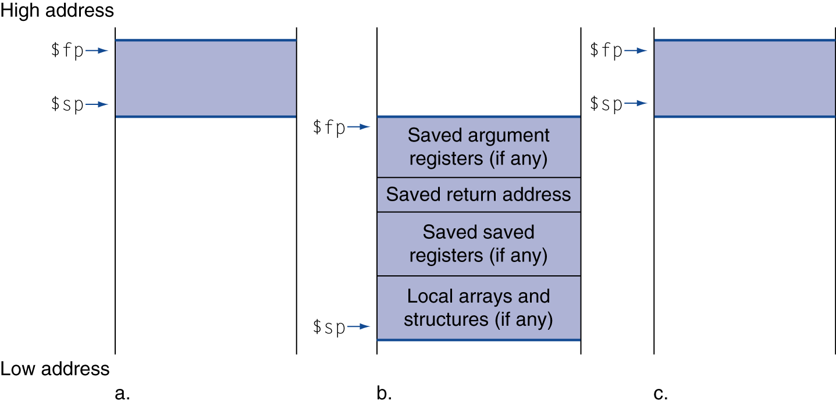
Local Data on the Stack
Local data allocated by callee
e.g., C automatic variables
Procedure frame (activation record)
Used by some compilers to manage stack storage

Slide 93
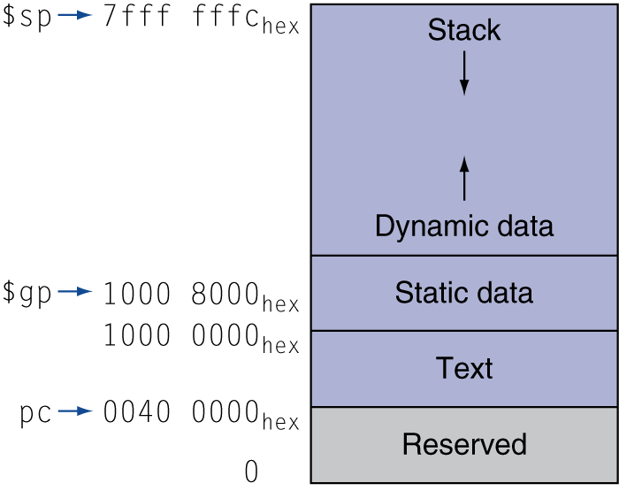
Memory Layout
Text: program code
Static data: global variables
e.g., static variables in C, constant arrays and strings
$gp initialized to address allowing ±offsets into this segment
Dynamic data: heap
E.g., malloc in C, new in Java
Stack: automatic storage

Slide 94
Why Procedure Conventions?
Definitions
Caller: function making the call, using jal
Callee: function being called
Procedure conventions as a contract between the Caller and the Callee
If both the Caller and Callee obey the procedure conventions, there are significant benefits
People who have never seen or even communicated with each other can write functions that work together
Recursion functions work correctly

Slide 95
Caller’s Rights, Callee’s Rights
Callees’ rights:
Right to use VAT registers freely
Right to assume arguments are passed correctly
To ensure callees’s right, caller saves registers:
Return address $ra
Arguments $a0, $a1, $a2, $a3
Return value $v0, $v1
$t Registers $t0 - $t9
Callers’ rights:
Right to use S registers without fear of being overwritten by callee
Right to assume return value will be returned correctly
To ensure caller’s right, callee saves registers:
$s Registers $s0 - $s7

Slide 96
Contract in Function Calls (1/2)
Caller’s responsibilities (how to call a function)
Slide $sp down to reserve memory: e.g., addi $sp, $sp, -28
Save $ra on stack because jal clobbers it: e.g., sw $ra, 24 ($sp)
If still need their values after function call, save $v, $a, $t on stack or copy to $s registers
Put first 4 words of arguments in $a0-3, additional arguments go on stack: “a4” is 16($sp)
jal to the desired function
Receive return values in $v0, $v1
Undo first steps: e.g. lw $t0, 20($sp) lw $ra, 24($sp) addi $sp, $sp, 28

Slide 97
Contract in Function Calls (2/2)
Callee’s responsibilities (i.e. how to write a function)
If using $s or big local structures, slide $sp down to reserve memory: e.g., addi $sp, $sp, -48
If using $s, save before using: e.g., sw $s0, 44($sp)
Receive arguments in $a0-3, additional arguments on stack
Run the procedure body
If not void, put return values in $v0,1
If applicable, undo first two steps: e.g., lw $s0, 44($sp) addi $sp, $sp, 48
jr $ra

Slide 98
Outline
Instruction set architecture (using MIPS ISA as an example)
Operands
Register operands and their organization
Memory operands, data transfer
Immediate operands
Signed and unsigned numbers
Representing instructions
Operations
Logical
Decision making and branches
Supporting procedures in hardware
Communicating with people
Addressing for 32-bit immediate and addresses
Translating and starting a program
A sort example
Arrays versus pointers
ARM and x86 instruction sets

Slide 99
Character Data
Byte-encoded character sets
ASCII: 128 characters
95 graphic, 33 control
Latin-1: 256 characters
ASCII, +96 more graphic characters
Unicode: 32-bit character set
Used in Java, C++ wide characters, …
Most of the world’s alphabets, plus symbols
UTF-8, UTF-16: variable-length encodings

Slide 100
Byte/Halfword Operations
Could use bitwise operations
MIPS byte/halfword load/store
String processing is a common case
lb rt, offset(rs) lh rt, offset(rs)
Sign extend to 32 bits in rt
lbu rt, offset(rs) lhu rt, offset(rs)
Zero extend to 32 bits in rt
sb rt, offset(rs) sh rt, offset(rs)
Store just rightmost byte/halfword

Slide 101
Load Byte Signed/Unsigned
$t0
…
12
F7
F7
F7
F0
…
$t1
lb $t1, 0($t0)
FFFFFF
F7
Sign-extended
lbu $t2, 0($t0)
$t2
000000
F7
Zero-extended
Instruction Set-100
Notes:
(Make noise) Back row! You in the (describe clothing)! I do a load byte from t0 to t1. What do I get in t1?
F7? Is there anything you would like to add to your statement? So your final answer is F7? (Alarm.wav)

Slide 102
String Copy Example
C code (naïve):
Null-terminated string
void strcpy (char x[], char y[]) { int i; i = 0; while ((x[i]=y[i])!='\0') i += 1; }
Addresses of x, y in $a0, $a1
i in $s0

Slide 103
String Copy Example
MIPS code:
strcpy: addi $sp, $sp, -4 # adjust stack for 1 item sw $s0, 0($sp) # save $s0 add $s0, $zero, $zero # i = 0 L1: add $t1, $s0, $a1 # addr of y[i] in $t1 lbu $t2, 0($t1) # $t2 = y[i] add $t3, $s0, $a0 # addr of x[i] in $t3 sb $t2, 0($t3) # x[i] = y[i] beq $t2, $zero, L2 # exit loop if y[i] == 0 addi $s0, $s0, 1 # i = i + 1 j L1 # next iteration of loop L2: lw $s0, 0($sp) # restore saved $s0 addi $sp, $sp, 4 # pop 1 item from stack jr $ra # and return

Slide 104
Outline
Instruction set architecture (using MIPS ISA as an example)
Operands
Register operands and their organization
Memory operands, data transfer
Immediate operands
Signed and unsigned numbers
Representing instructions
Operations
Logical
Decision making and branches
Supporting procedures in hardware
Communicating with people
Addressing for 32-bit immediate and addresses
Translating and starting a program
A sort example
Arrays versus pointers
ARM and x86 instruction sets

Slide 105
32-bit Constants
Most constants are small
16-bit immediate is sufficient
For the occasional 32-bit constant
Load Upper Immediate:
lui rt, constant
Copies 16-bit constant to left 16 bits of rt
Clears right 16 bits of rt to 0
Load a big number to s0 using lui
0000 0000 0011 1101 0000 1001 0000 0000
lui $s0, 61
0000 0000 0011 1101 0000 0000 0000 0000
S0
ori $s0, $s0, 2304
0000 0000 0011 1101 0000 1001 0000 0000
S0

Slide 106
Branch Addressing (1)
Use I-format:
opcode specifies beq or bne
Rs and Rt specify registers to compare
What can immediate specify? PC-relative addressing
Immediate is only 16 bits, but PC is 32-bit => immediate cannot specify entire address
Loops are generally small: < 50 instructions
Though we want to branch to anywhere in memory, a single branch only need to change PC by a small amount
How to use PC-relative addressing
16-bit immediate as a signed two’s complement integer to be added to the PC if branch taken
Now we can branch +/- 2¹⁵ bytes from the PC ?
opcode
rs
rt
immediate

Slide 107
Branch Addressing (2)
Immediate specifies word address
Instructions are word aligned (byte address is always a multiple of 4, i.e., it ends with 00 in binary)
The number of bytes to add to the PC will always be a multiple of 4
Specify the immediate in words (confusing?)
Now, we can branch +/- 2¹⁵ words from the PC (or +/- 2¹⁷ bytes), handle loops 4 times as large
Immediate specifies PC + 4
Due to hardware, add immediate to (PC+4), not to PC
If branch not taken: PC = PC + 4
If branch taken: PC = (PC+4) + (immediate*4)

Slide 108
Branch Example
MIPS Code:
Loop: beq $9,$0,End add $8,$8,$10 addi $9,$9,-1 j Loop End:
Branch is I-Format:
opcode = 4 (look up in table)
rs = 9 (first operand)
rt = 0 (second operand)
immediate = ???
Number of instructions to add to (or subtract from) the PC, starting at the instruction following the branch => immediate = 3
opcode
rs
rt
immediate

Slide 109
Branch Example
MIPS Code:
Loop: beq $9,$0,End add $8,$8,$10 addi $9,$9,-1 j Loop
End:
decimal representation:
binary representation:
4
9
0
3
000100
01001
00000
0000000000000011

Slide 110
Jump Addressing (1/3)
For branches, we assumed that we won’t want to branch too far, so we can specify change in PC.
For general jumps (j and jal), we may jump to anywhere in memory.
Ideally, we could specify a 32-bit memory address to jump to.
Unfortunately, we can’t fit both a 6-bit opcode and a 32-bit address into a single 32-bit word, so we compromise.

Slide 111
Jump Addressing (2/3)
Define “fields” of the following number of bits each:
As usual, each field has a name:
Key concepts:
Keep opcode field identical to R-format and I-format for consistency
Combine other fields to make room for target address
Optimization:
Jumps only jump to word aligned addresses
last two bits are always 00 (in binary)
specify 28 bits of the 32-bit bit address
6 bits
26 bits
opcode
target address

Slide 112
Jump Addressing (3/3)
Where do we get the other 4 bits?
Take the 4 highest order bits from the PC
Technically, this means that we cannot jump to anywhere in memory, but it’s adequate 99.9999…% of the time, since programs aren’t that long
Linker and loader avoid placing a program across an address boundary of 256 MB
Summary:
New PC = PC[31..28] || target address (26 bits) || 00
Note: II means concatenation 4 bits || 26 bits || 2 bits = 32-bit address
If we absolutely need to specify a 32-bit address:
Use jr $ra # jump to the address specified by $ra

Slide 113
Target Addressing Example
Loop code from earlier example
Assume Loop at location 80000
Loop: sll $t1, $s3, 2 | 80000 | 0 | 0 | 19 | 9 | 2 | 0
add $t1, $t1, $s6 | 80004 | 0 | 9 | 22 | 9 | 0 | 32
lw $t0, 0($t1) | 80008 | 35 | 9 | 8 | 0
bne $t0, $s5, Exit | 80012 | 5 | 8 | 21 | 2
addi $s3, $s3, 1 | 80016 | 8 | 19 | 19 | 1
j Loop | 80020 | 2 | 20000
Exit: … | 80024
80016 + 2 x 4 = 80024
20000 x 4 = 80000

Slide 114
Branching Far Away
If branch target is too far to encode with 16-bit offset, assembler rewrites the code
Example
beq $s0,$s1, L1
↓
bne $s0,$s1, L2 j L1 L2: …

Slide 115
MIPS Addressing Mode
1. Immediate addressing
op | rs | rt | Immediate
2. Register addressing
op | rs | rt | rd | … | funct
Registers
Register
3. Base addressing
op | rs | rt | Address
Memory
Register
+
Byte
Halfword
Word

Slide 116
MPIS Addressing Modes
4. PC-relative addressing
op | rs | rt | Address
Memory
PC
+
Word
5. Pseudodirect addressing
op | Address
Memory
PC
Word

Slide 117
Outline
Instruction set architecture (using MIPS ISA as an example)
Operands
Register operands and their organization
Memory operands, data transfer
Immediate operands
Signed and unsigned numbers
Representing instructions
Operations
Logical
Decision making and branches
Supporting procedures in hardware
Communicating with people
Addressing for 32-bit immediate and addresses
Translating and starting a program
A sort example
Arrays versus pointers
ARM and x86 instruction sets

Slide 118
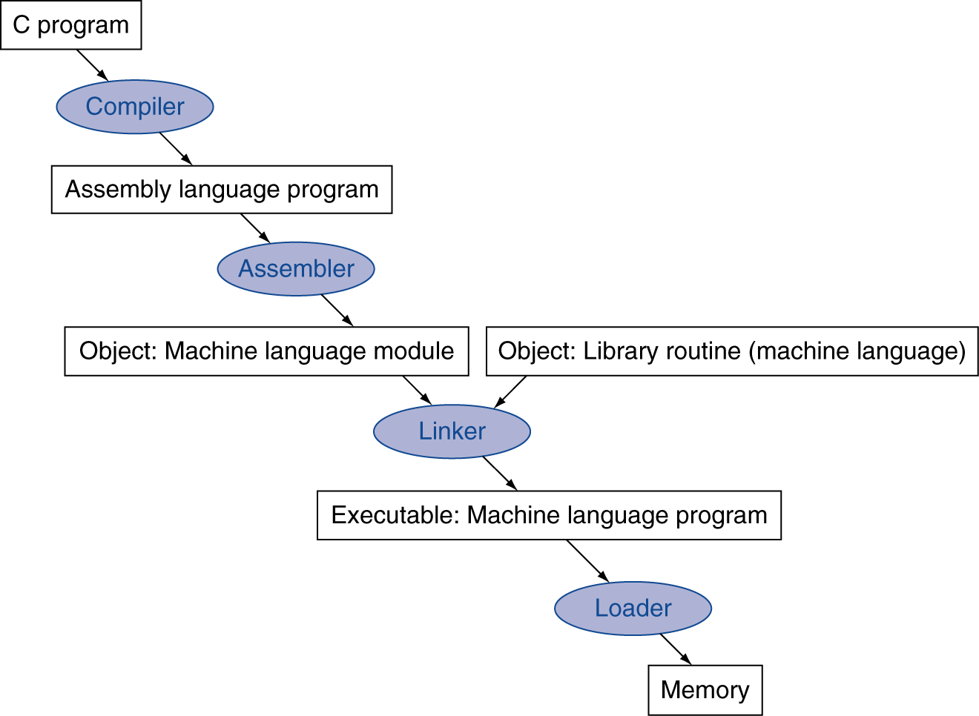
Translation and Startup
Many compilers produce object modules directly
Static linking

Slide 119
Assembler Pseudoinstructions
Most assembler instructions represent machine instructions one-to-one
Pseudo instructions: figments of the assembler’s imagination
move $t0, $t1 → add $t0, $zero, $t1
blt $t0, $t1, L → slt $at, $t0, $t1 bne $at, $zero, L
$at (register 1): assembler temporary

Slide 120
Producing an Object Module
Assembler (or compiler) translates program into machine instructions
Provides information for building a complete program from the pieces
Header: described contents of object module
Text segment: translated instructions
Static data segment: data allocated for the life of the program
Relocation info: for contents that depend on absolute location of loaded program
Symbol table: global definitions and external refs
Debug info: for associating with source code

Slide 121
Linking Object Modules
Produces an executable image
1. Merges segments
2. Resolve labels (determine their addresses)
3. Patch location-dependent and external refs
Could leave location dependencies for fixing by a relocating loader
But with virtual memory, no need to do this
Program can be loaded into absolute location in virtual memory space

Slide 122
Loading a Program
Load from image file on disk into memory
1. Read header to determine segment sizes
2. Create virtual address space
3. Copy text and initialized data into memory
Or set page table entries so they can be faulted in
4. Set up arguments on stack
5. Initialize registers (including $sp, $fp, $gp)
6. Jump to startup routine
Copies arguments to $a0, … and calls main
When main returns, do exit syscall

Slide 123
Outline
Instruction set architecture (using MIPS ISA as an example)
Operands
Register operands and their organization
Memory operands, data transfer
Immediate operands
Signed and unsigned numbers
Representing instructions
Operations
Logical
Decision making and branches
Supporting procedures in hardware
Communicating with people
Addressing for 32-bit immediate and addresses
Translating and starting a program
A sort example
Arrays versus pointers
ARM and x86 instruction sets

Slide 124
C Sort Example
Illustrates use of assembly instructions for a C bubble sort function
Swap procedure (leaf)
void swap(int v[], int k) { int temp; temp = v[k]; v[k] = v[k+1]; v[k+1] = temp; }
v in $a0, k in $a1, temp in $t0

Slide 125
The Procedure Swap
swap: sll $t1, $a1, 2 # $t1 = k * 4
add $t1, $a0, $t1 # $t1 = v+(k*4)
# (address of v[k])
lw $t0, 0($t1) # $t0 (temp) = v[k]
lw $t2, 4($t1) # $t2 = v[k+1]
sw $t2, 0($t1) # v[k] = $t2 (v[k+1])
sw $t0, 4($t1) # v[k+1] = $t0 (temp)
jr $ra # return to calling routine

Slide 126
The Sort Procedure in C
Non-leaf (calls swap)
void sort (int v[], int n)
{
int i, j;
for (i = 0; i < n; i += 1) {
for (j = i – 1;
j >= 0 && v[j] > v[j + 1];
j -= 1) {
swap(v,j);
}
}
}
v in $a0, k in $a1, i in $s0, j in $s1

Slide 127
The Procedure Body
move $s2, $a0 # save $a0 into $s2
move $s3, $a1 # save $a1 into $s3
move $s0, $zero # i = 0
for1tst: slt $t0, $s0, $s3 # $t0 = 0 if $s0 ≥ $s3 (i ≥ n)
beq $t0, $zero, exit1 # go to exit1 if $s0 ≥ $s3 (i ≥ n)
addi $s1, $s0, –1 # j = i – 1
for2tst: slti $t0, $s1, 0 # $t0 = 1 if $s1 < 0 (j < 0)
bne $t0, $zero, exit2 # go to exit2 if $s1 < 0 (j < 0)
sll $t1, $s1, 2 # $t1 = j * 4
add $t2, $s2, $t1 # $t2 = v + (j * 4)
lw $t3, 0($t2) # $t3 = v[j]
lw $t4, 4($t2) # $t4 = v[j + 1]
slt $t0, $t4, $t3 # $t0 = 0 if $t4 ≥ $t3
beq $t0, $zero, exit2 # go to exit2 if $t4 ≥ $t3
move $a0, $s2 # 1st param of swap is v (old $a0)
move $a1, $s1 # 2nd param of swap is j
jal swap # call swap procedure
addi $s1, $s1, –1 # j –= 1
j for2tst # jump to test of inner loop
exit2: addi $s0, $s0, 1 # i += 1
j for1tst # jump to test of outer loop
Move params
Outer loop
Inner loop
Pass params & call
Inner loop
Outer loop

Slide 128
The Full Procedure
sort: addi $sp,$sp, –20 # make room on stack for 5 registers
sw $ra, 16($sp) # save $ra on stack
sw $s3,12($sp) # save $s3 on stack
sw $s2, 8($sp) # save $s2 on stack
sw $s1, 4($sp) # save $s1 on stack
sw $s0, 0($sp) # save $s0 on stack
… # procedure body
…
exit1: lw $s0, 0($sp) # restore $s0 from stack
lw $s1, 4($sp) # restore $s1 from stack
lw $s2, 8($sp) # restore $s2 from stack
lw $s3,12($sp) # restore $s3 from stack
lw $ra,16($sp) # restore $ra from stack
addi $sp,$sp, 20 # restore stack pointer
jr $ra # return to calling routine

Slide 129
Effect of Compiler Optimization
Compiled with gcc for Pentium 4 under Linux

Slide 130
Effect of Language and Algorithm

Slide 131
Lessons Learnt
Instruction count and CPI are not good performance indicators in isolation
Compiler optimizations are sensitive to the algorithm
Nothing can fix a dumb algorithm!

Slide 132
Outline
Instruction set architecture (using MIPS ISA as an example)
Operands
Register operands and their organization
Memory operands, data transfer
Immediate operands
Signed and unsigned numbers
Representing instructions
Operations
Logical
Decision making and branches
Supporting procedures in hardware
Communicating with people
Addressing for 32-bit immediate and addresses
Translating and starting a program
A sort example
Arrays versus pointers
ARM and x86 instruction sets

Slide 133
Arrays vs. Pointers
Array indexing involves
Multiplying index by element size
Adding to array base address
Pointers correspond directly to memory addresses
Can avoid indexing complexity

Slide 134
Example: Clearing an Array
clear1(int array[], int size) { int i; for (i = 0; i < size; i += 1) array[i] = 0; } | clear2(int *array, int size) { int *p; for (p = &array[0]; p < &array[size]; p = p + 1) *p = 0; }
move $t0,$zero # i = 0 loop1: sll $t1,$t0,2 # $t1 = i * 4 add $t2,$a0,$t1 # $t2 = # &array[i] sw $zero, 0($t2) # array[i] = 0 addi $t0,$t0,1 # i = i + 1 slt $t3,$t0,$a1 # $t3 = # (i < size) bne $t3,$zero,loop1 # if (…) # goto loop1 | move $t0, $a0 # p = & array[0] sll $t1, $a1, 2 # $t1 = size * 4 add $t2,$a0,$t1 # $t2 = # &array[size] loop2: sw $zero,0($t0) # Memory[p] = 0 addi $t0,$t0,4 # p = p + 4 slt $t3,$t0,$t2 # $t3 = #(p<&array[size]) bne $t3,$zero,loop2 # if (…) # goto loop2

Slide 135
Comparison of Array vs. Ptr
Multiply “strength reduced” to shift (strength reduction)
Array version requires shift to be inside loop
Part of index calculation for incremented i
c.f. incrementing pointer
Compiler can achieve same effect as manual use of pointers
Eliminating array address calculations within loop (induction variable elimination): 6 instructions reduced to 4 in loop
Better to make program clearer and safer

Slide 136
Outline
Instruction set architecture (using MIPS ISA as an example)
Operands
Register operands and their organization
Memory operands, data transfer
Immediate operands
Signed and unsigned numbers
Representing instructions
Operations
Logical
Decision making and branches
Supporting procedures in hardware
Communicating with people
Addressing for 32-bit immediate and addresses
Translating and starting a program
A sort example
Arrays versus pointers
ARM and x86 instruction sets

Slide 137
ARM & MIPS Similarities
ARM: the most popular embedded core
Similar basic set of instructions to MIPS
 | ARM | MIPS
Date announced | 1985 | 1985
Instruction size | 32 bits | 32 bits
Address space | 32-bit flat | 32-bit flat
Data alignment | Aligned | Aligned
Data addressing modes | 9 | 3
Registers | 15 × 32-bit | 31 × 32-bit
Input/output | Memory mapped | Memory mapped

Slide 138
Compare and Branch in ARM
Uses condition codes for result of an arithmetic/logical instruction
Negative, zero, carry, overflow
Compare instructions to set condition codes without keeping the result
Each instruction can be conditional
Top 4 bits of instruction word: condition value
Can avoid branches over single instructions

Slide 139
The Intel x86 ISA
Evolution with backward compatibility
8080 (1974): 8-bit microprocessor
Accumulator, plus 3 index-register pairs
8086 (1978): 16-bit extension to 8080
Complex instruction set (CISC)
8087 (1980): floating-point coprocessor
Adds FP instructions and register stack
80286 (1982): 24-bit addresses, MMU
Segmented memory mapping and protection
80386 (1985): 32-bit extension (now IA-32)
Additional addressing modes and operations
Paged memory mapping as well as segments

Slide 140
The Intel x86 ISA
Further evolution…
i486 (1989): pipelined, on-chip caches and FPU
Compatible competitors: AMD, Cyrix, …
Pentium (1993): superscalar, 64-bit datapath
Later versions added MMX (Multi-Media eXtension) instructions
The infamous FDIV bug
Pentium Pro (1995), Pentium II (1997)
New microarchitecture (see Colwell, The Pentium Chronicles)
Pentium III (1999)
Added SSE (Streaming SIMD Extensions) and associated registers
Pentium 4 (2001)
New microarchitecture
Added SSE2 instructions

Slide 141
The Intel x86 ISA
Further evolution…
i486 (1989): pipelined, on-chip caches and FPU
Compatible competitors: AMD, Cyrix, …
Pentium (1993): superscalar, 64-bit datapath
Later versions added MMX (Multi-Media eXtension) instructions
Pentium Pro (1995), Pentium II (1997)
New microarchitecture (see Colwell, The Pentium Chronicles)
Pentium III (1999)
Added SSE (Streaming SIMD Extensions) and associated registers
Pentium 4 (2001)
Added SSE2 instructions
…….
Advanced Vector Extension (announced 2008)
Longer SSE registers, more instructions
Technical elegance ≠ market success

Slide 142
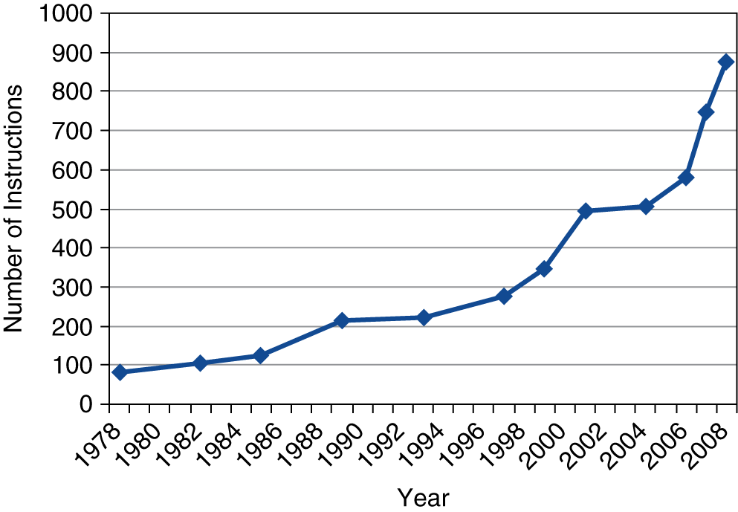
X86 Instruction Set
Backward compatibility ⇒ instruction set doesn’t change
But they do accrete more instructions
x86 instruction set

Slide 143
Implementing IA-32
Complex instruction set makes implementation difficult
Hardware translates instructions to simpler microoperations
Simple instructions: 1–1
Complex instructions: 1–many
Microengine similar to RISC
Market share makes this economically viable
Comparable performance to RISC
Compilers avoid complex instructions

Slide 144
Fallacies
Powerful instruction ⇒ higher performance
Fewer instructions required
But complex instructions are hard to implement
May slow down all instructions, including simple ones
Compilers are good at making fast code from simple instructions
Use assembly code for high performance
But modern compilers are better at dealing with modern processors
More lines of code ⇒ more errors and less productivity

Slide 145
Pitfalls
Sequential words are not at sequential addresses
Increment by 4, not by 1!
Keeping a pointer to an automatic variable after procedure returns
e.g., passing pointer back via an argument
Pointer becomes invalid when stack popped

Slide 146
Concluding Remarks
Design principles
1. Simplicity favors regularity
2. Smaller is faster
3. Make the common case fast
4. Good design demands good compromises
MIPS: typical of RISC ISAs
c.f. x86

Slide 147
Concluding Remarks
Measure MIPS instruction executions in benchmark programs
Consider making the common case fast
Consider compromises
Instruction class | MIPS examples | SPEC2006 Int | SPEC2006 FP
Arithmetic | add, sub, addi | 16% | 48%
Data transfer | lw, sw, lb, lbu, lh, lhu, sb, lui | 35% | 36%
Logical | and, or, nor, andi, ori, sll, srl | 12% | 4%
Cond. Branch | beq, bne, slt, slti, sltiu | 34% | 8%
Jump | j, jr, jal | 2% | 0%

